Slide 1
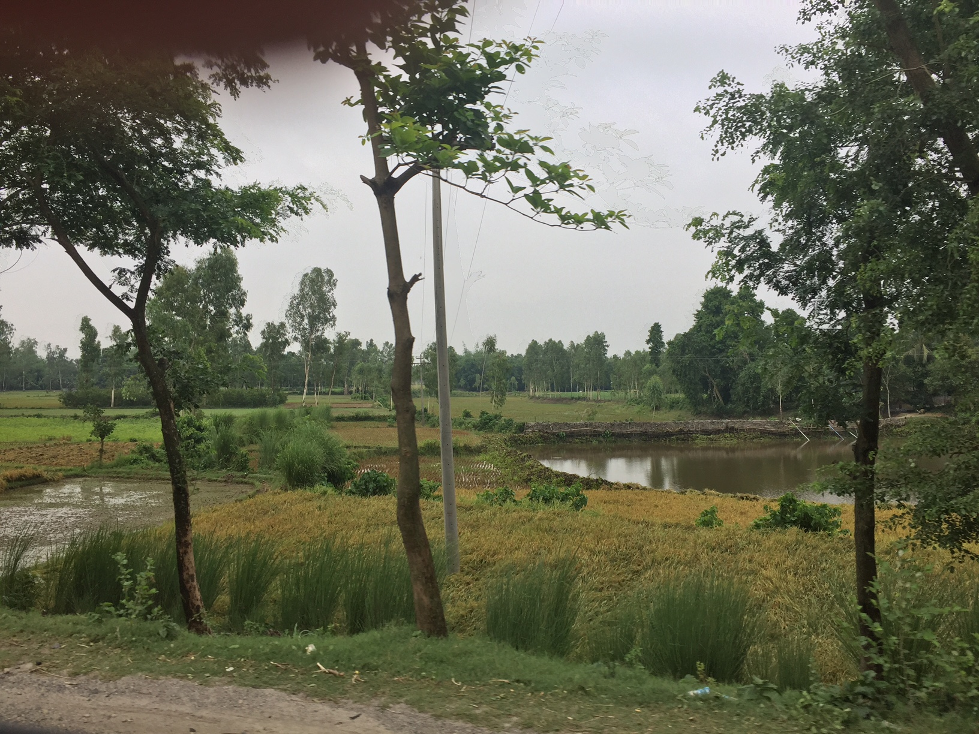
How does empowerment influence within-household differences in adult nutritional status?: Findings from panel data from rural Bangladesh
Erin C Lentz
University of Texas
(erinclentz@utexas.edu)
and
Ghida Ismail

Slide 2
In recent qualitative work with colleagues, women in rural South Asia describe eating last and least*
From NW Bangladesh :
Gohin, mother of three children, explains that her husband “doesn’t feed us well. He only takes care of himself and [his parents]. What little food we have, I bring from my parents’ house. Sometimes, I skip meals to meet the needs of my children.”
But, women also report this can be mediated by other factors, including age, income, civil society membership, existence of mother-in-law in the home: some are potential aspects of empowerment
Kalpana, who recently became a civil society member and works outside the home at a mill, says “I used to feed my husband first, then I would eat the leftovers. … Now, we all sit together to eat.”
*See Narayanan et al. (2017); Lentz (2018); Lentz et al. (under review)

Slide 3
Long-standing research on intrahousehold outcomes
Emerges out of work on intrahousehold bargaining in 1980s and 1990s
(Behrman (1988); Senauer et al. (1988); Haddad and Kanbur (1990); Berhman and Deolaliker (1990); Pitt et al. (1990); Haddad et al. (1995))
Marcoux (2002) writes “evidence of pro-male biases in food consumption is scarce” (p. 275)
More recent work on dietary diversity
(Mangyo (2008); Villa et al. (2011); Rahman (2013)).
Less on anthropometric outcomes (although see D’Souza and Tandon 2018) and little on anthropometric outcomes with panel data
Notes:
Absence of evidence – not evidence of absence
In South Asia, dietary diversity, and caloric intake may be a poor measure
Qualitative work from Bangladesh and India find that many women report eating much smaller amounts of the most nutritious foods (or forgoing them altogether).
Thus, women may appear to have as diverse a diet as other members but it is less clear that they eat an adequate amount of high quality foods (Lentz et al. under review)
High rates of anemia among South Asian women suggests that for at least some micronutrients, they may not.

Slide 4
Question: what factors are associated with changes in BMI over time for male heads of households and their spouses?
Relatedly:
Does a partner’s nutritional status predict one’s own BMI?
Do empowerment-related measures matter?
What influences the likelihood of one person in a husband, wife pair being underweight while the other is not?
Village Dynamics in South Asia panel data: collected body mass index of household heads, their spouses, and other household members in rural Bangladesh.

Slide 5
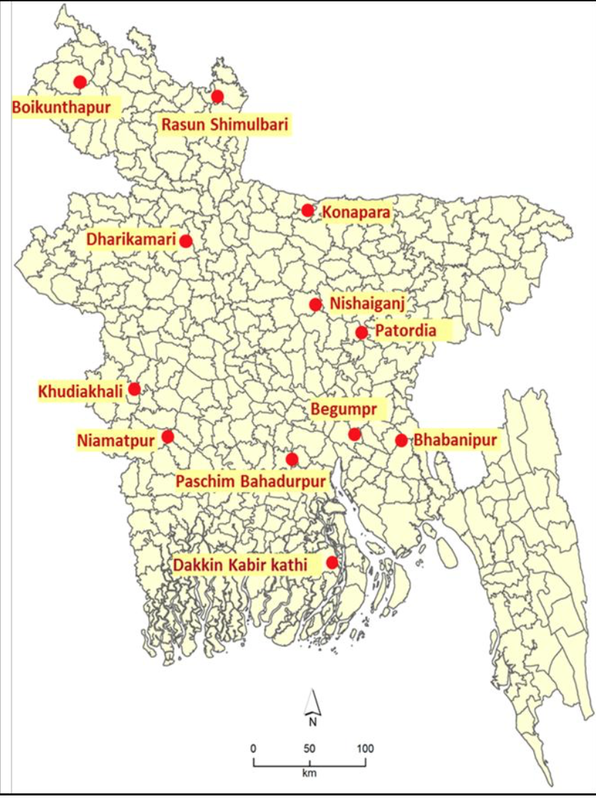
Village Dynamics in South Asia (VDSA) - Bangladesh
Purposive sample of 12 villages in Bangladesh
Random sample of about 50 households per village
VDSA focuses on rural livelihoods and assets
Missing detailed data on dietary intake, health and health seeking behaviors
Data on wealth, land, social programs, intrahousehold decision-making
Notes:
Intrahousehold decision-making is a common, but narrow conceptualization of empowerment (Kabeer 1999; Pratley 2016; Narayanan et al. under review).

Slide 6
Village Dynamics in South Asia (VDSA) - Bangladesh
BMI data collected annually 2011-2014 for adult household members
Limit estimations to male household heads and their spouses
Exclude pregnant and disabled individuals
Include age range of 20 - 60
BMI as an outcome:
BMI (kg/m²) < 18.5 indicates malnutrition in adults
Unbalanced panel: in 2011, 273 hh; in 2012, 272 hh; in 2013, 278 hh; in 2014, 280 hh
Notes:
High rates (>98.5%) of BMI reporting for male household heads and their spouses
BMI measures for other household members shows missing not at random: occupation type, position in household, and others predict likelihood of BMI not being collected

Slide 7
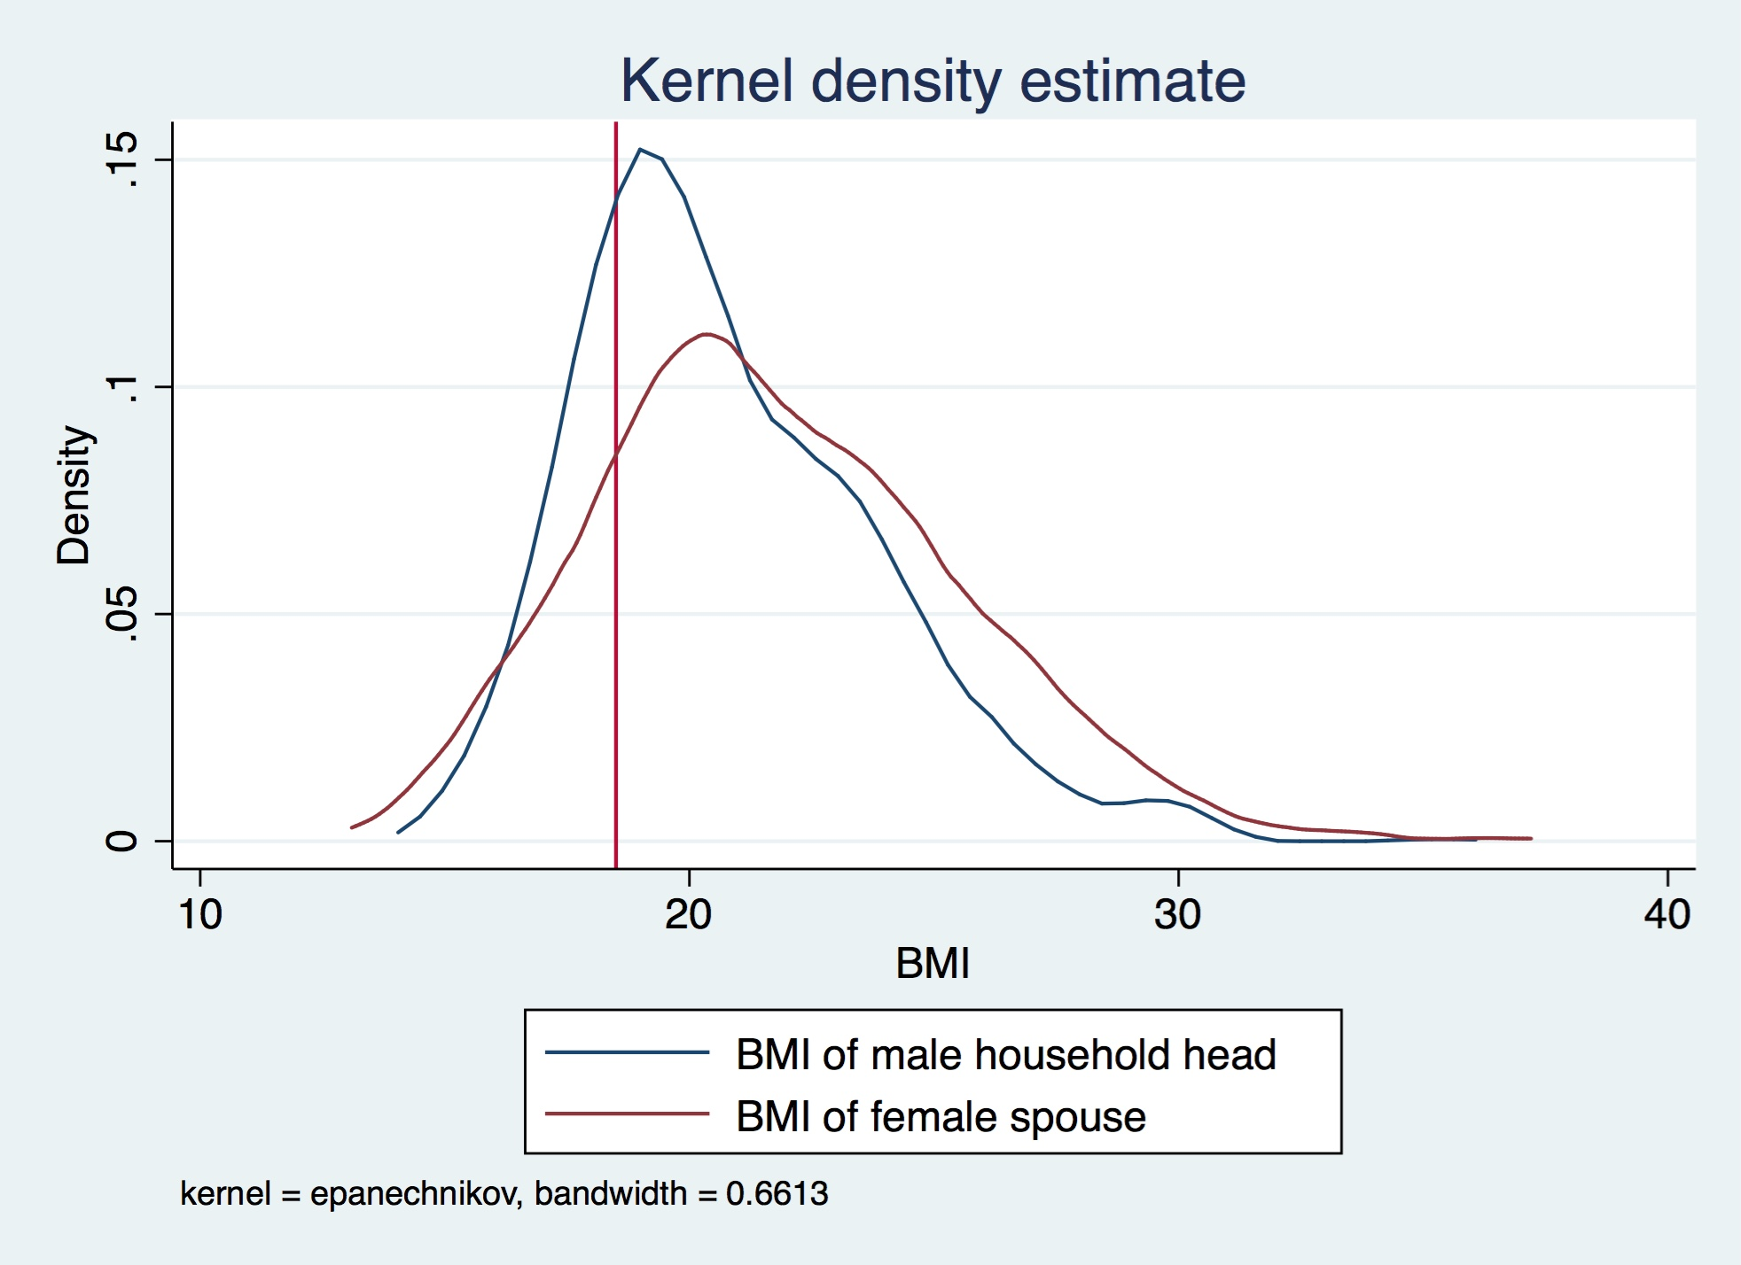
BMI for male heads and female spouses for all years
About 24% of male household heads are underweight at some point during 2011- 2014
About 19% of female spouses are underweight at some point during 2011- 2014

Slide 8
Role of Empowerment: Conceptual Pathways between Ag and Nutrition
National economic growth
National nutrition profile
Enabling environment
Food market environment
Agricultural Production
Health environment
Natural resources
Household assets and livelihoods
Nutrition and health knowledge
*individual nutrition outcomes refer to the general population, including women, men, and adolescents (not just mothers and children)
Food production & gathering
Processing & storage
Individual nutrition outcomes*
Food expenditure
Food access
Diet
Child nutrition outcomes
Agricultural income
Health care
Health status
Non-food expenditure
Mother’s nutrition outcomes
Caring capacity & practices
Women’s empowerment
Female energy expenditure
Individual
Household
Source: Adapted from Kadiyala et al (2014), Herforth and Harris (2013), Gillespie et al (2012) and Headey et al (2011).
Notes:
how does agriculture affect nutrition? Lets look at the household level…
Short answer: complicated.
Long answer: role of women’s empowerment is often considered important, but is a black box. How to measure? Particularly when we care about nutritional outcomes of women and their family members?

Slide 9
BMI for individuals
BMI_{it} = a + bX_{it} + cA_{ht} + dE_{it} + e_{it} + f_{i} + t_{t}
i = individual; t = year; h = household
X is a vector of individual demographic variables; A is household level variables; E is empowerment related variables including (1) assets and access to credit (2) decision-making within the household; and (3) partner’s attributes, including differences in age and education relative to the spouse, and BMI
Robust standard errors, clustered at individual
Estimate BMI of heads and their wives separately
BMI levels and trends can differ by gender (Finucane et al. 2011)
Present fixed effects results
Notes:
Hausman: Reject the null that random effects model is appropriate for men
By controlling for time invariant factors, consider changes within households and individuals over time
Robust standard errors, clustered at individual, to address heteroskedasticity

Slide 10
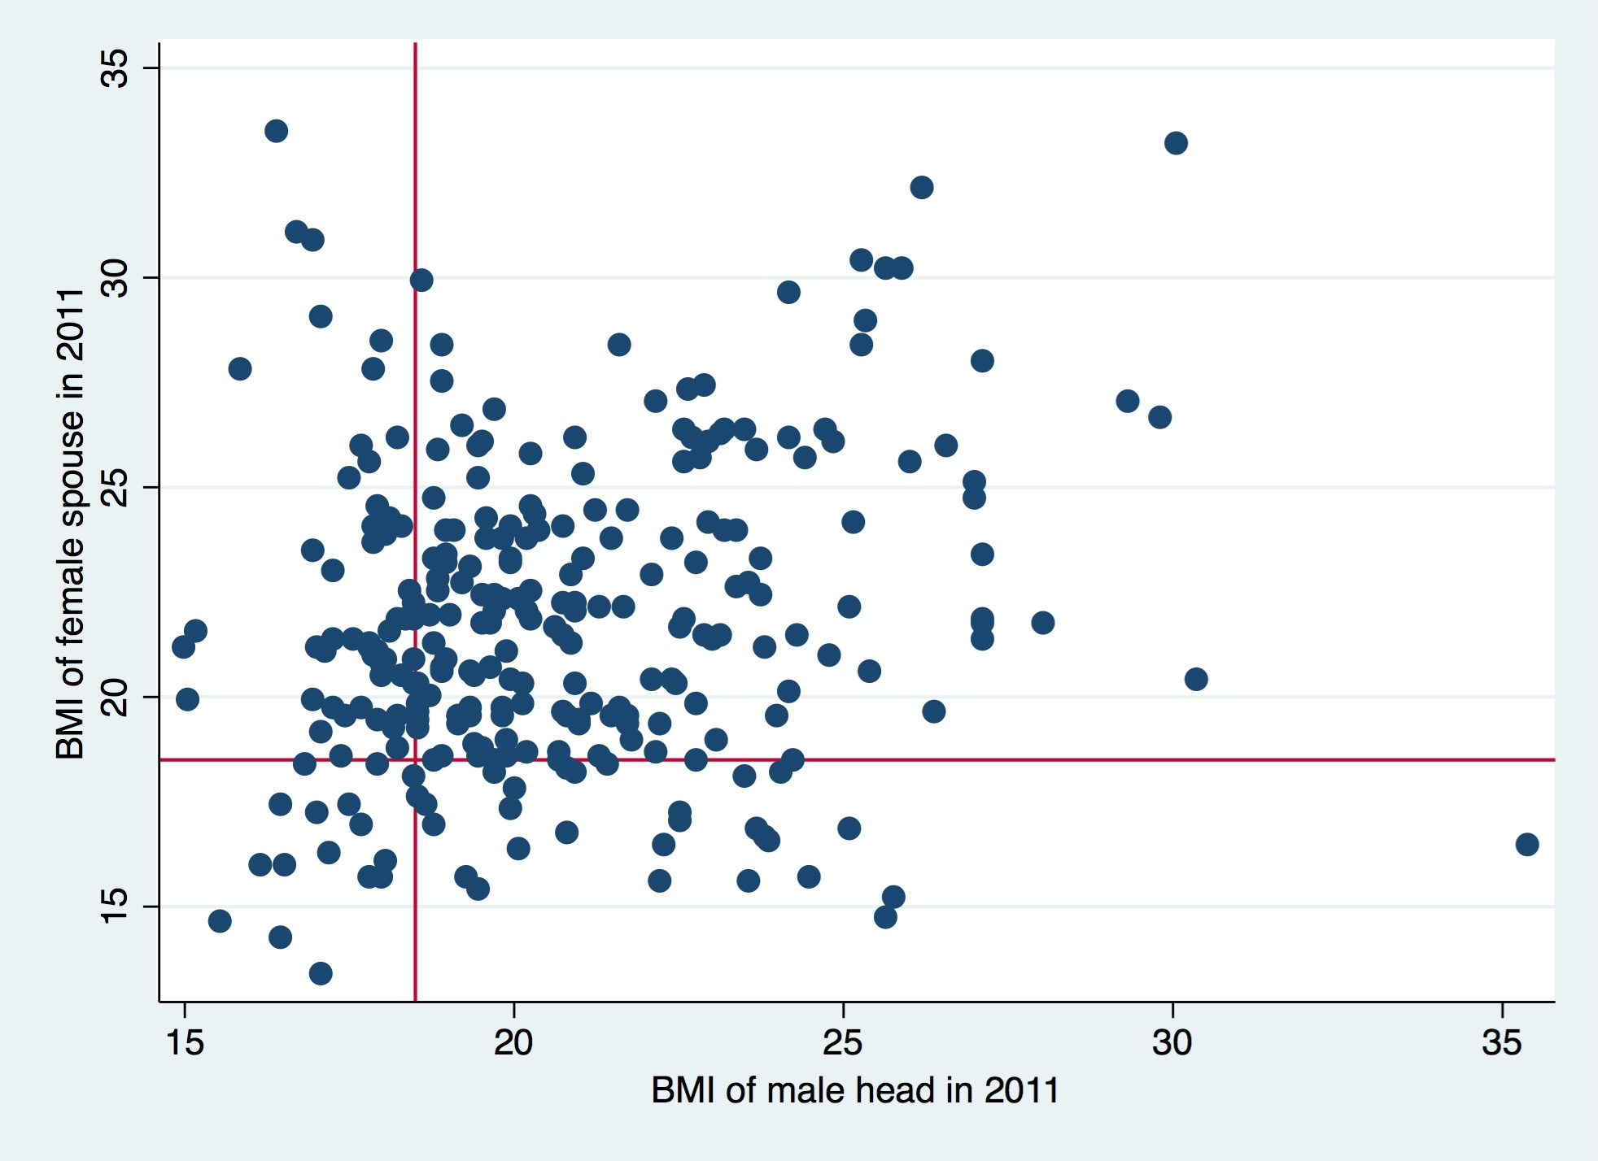
BMI of male household head and spouse pairs for 2011 (n = 272 pairs)
 | Female spouse’s BMI >=18.5% | Female spouse’s BMI <18.5%
Male Head’s BMI >= 18.5% | 64% | 12%
Male Head’s BMI < 18.5% | 18% | 6%
Notes:
First – sizable % of husbands have low BMI when their wives do not.

Slide 11
Is BMI of an individual predicted by partner’s BMI?
 | (1) | (2)
 | BMI of Wife | BMI of Husband
BMI of spouse | 0.0468 | 0.0429
 | (0.0822) | (0.0741)
2012 | -0.0382 | -0.0603
 | (0.0779) | (0.103)
2013 | 0.312*** | 0.00948
 | (0.0887) | (0.104)
2014 | 0.825*** | 0.184
 | (0.111) | (0.120)
Constant | 20.76*** | 19.83***
 | (1.696) | (1.623)
Observations | 1,124 | 1,098
R-squared | 0.128 | 0.017
Number of individuals | 336 | 330
Robust standard errors in parentheses
*** p<0.01, ** p<0.05, * p<0.1

Slide 12
What contributes to changes in BMIs over time?: women
VARIABLES |  | BMI (1) | BMI (2) | BMI (3) | BMI (4) | BMI (5)
Credit |  | -0.300** | -0.288** | -0.282** | -0.271* | -0.275*
BMI of Spouse |  |  |  | 0.0285 | 0.0285 | 0.0293
Age diff (head - spouse) |  |  |  | 0.750*** | 0.751*** | 0.637
Educ diff (head - spouse) |  |  |  | -0.104* | -0.104* | -0.0962
Woman in HH accessed credit = 1 |  |  |  |  | -0.0169 | -0.0166
Woman in HH involved in major decision(s) = 1 |  |  |  |  |  | 0.129
Development programs |  | NO | YES | YES | YES | YES
Demographics |  | YES | YES | YES | YES | YES
Household Assets, value of assets, food stored |  | YES | YES | YES | YES | YES
Year fixed effects, constant |  | YES | YES | YES | YES | YES
Observations (# of ind) |  | 1,399 (402) | 1,399 (402) | 1,118 (335) | 1,118 (335) | 1,118 (335)
R-squared |  | 0.123 | 0.129 | 0.174 | 0.174 | 0.174
Notes:
(2) Adds in development programs
(3) Adds in spouse’s attributes
(4) Adds in access to credit
Adds in involvement in major decisions

Slide 13
What contributes to changes in BMIs over time?: women
VARIABLES |  | BMI (1) | BMI (2) | BMI (3) | BMI (4) | BMI (5)
Credit |  | -0.300** | -0.288** | -0.282** | -0.271* | -0.275*
BMI of Spouse |  |  |  | 0.0285 | 0.0285 | 0.0293
Age diff (head - spouse) |  |  |  | 0.750*** | 0.751*** | 0.637
Educ diff (head - spouse) |  |  |  | -0.104* | -0.104* | -0.0962
Woman in HH accessed credit = 1 |  |  |  |  | -0.0169 | -0.0166
Woman in HH involved in major decision(s) = 1 |  |  |  |  |  | 0.129
Development programs |  | NO | YES | YES | YES | YES
Demographics |  | YES | YES | YES | YES | YES
Household Assets, value of assets, food stored |  | YES | YES | YES | YES | YES
Year fixed effects, constant |  | YES | YES | YES | YES | YES
Observations (# of ind) |  | 1,399 (402) | 1,399 (402) | 1,118 (335) | 1,118 (335) | 1,118 (335)
R-squared |  | 0.123 | 0.129 | 0.174 | 0.174 | 0.174
Notes:
As we add in more detailed measures of women’s empowerment, the influence of age and education differences disappear, suggesting that women’s involvement in decision making can “make up” for education discrepancies.
Robust SE, clustered at ind level. Age and Age2 matter.

Slide 14
What contributes to changes in BMIs over time?: men
VARIABLES |  | BMI | BMI | BMI | BMI
Credit |  | 0.0879 | 0.0827 | 0.0541 | 0.0503
BMI of Spouse |  |  |  | 0.0103 | 0.0109
Age diff (head - spouse) |  |  |  | -0.632** | -0.465
Educ diff (head - spouse) |  |  |  | 0.0617** | 0.0624**
Woman in HH involved in major decision(s) = 1 |  |  |  |  | -0.195
MotherandChildDev1 |  |  | -0.219** | -0.193* | -0.191*
Other social programs |  | NO | YES | YES | YES
Demographics |  | YES | YES | YES | YES
Household Assets, value of assets, food stored |  | YES | YES | YES | YES
Year fixed effects, constant |  | YES | YES | YES | YES
Observations (# of ind) |  | 1,153 (339) | 1,153 (339) | 1,053 (318) | 1,053 (318)
R-squared |  | 0.053 | 0.060 | 0.067 | 0.068
Notes:
Also includes occupation (heavy labor = 1) % of land owned by the respondents.

Slide 15
What contributes to changes in BMIs over time?: men
VARIABLES |  | BMI | BMI | BMI | BMI
Credit |  | 0.0879 | 0.0827 | 0.0541 | 0.0503
BMI of Spouse |  |  |  | 0.0103 | 0.0109
Age diff (head - spouse) |  |  |  | -0.632** | -0.465
Educ diff (head - spouse) |  |  |  | 0.0617** | 0.0624**
Woman in HH involved in major decision(s) = 1 |  |  |  |  | -0.195
MotherandChildDev1 |  |  | -0.219** | -0.193* | -0.191*
Other social programs |  | NO | YES | YES | YES
Demographics |  | YES | YES | YES | YES
Household Assets, value of assets, food stored |  | YES | YES | YES | YES
Year fixed effects, constant |  | YES | YES | YES | YES
Observations (# of ind) |  | 1,153 (339) | 1,153 (339) | 1,053 (318) | 1,053 (318)
R-squared |  | 0.053 | 0.060 | 0.067 | 0.068
Notes:
Also includes occupation (heavy labor = 1) % of land owned by the respondents.

Slide 16
What contributes to changes in BMI over time?
Models explain two and a half times more variation for changes in women’s BMI than for men. (R-squared of 17.5% vs 6.8%)
Women:
Age is highly significant for women
Accessing credit is associated with lower BMI
Men
Education level is highly significant for men
Size of land holdings (from landless or near landless to mid-size farm)
Participation of the household in a Mothers and Child’s program is associated with lower BMI, even when accounting for household size.
Notes:
Accessing credit is associated with lower BMI – could be capturing need?

Slide 17
What contributes to changes in BMI over time?
For men and women – adding in variables associated with more decision-making power mitigates the effects of demographic differences between the spouses
Women who are able to make household decisions seem able to overcome initial demographic differences with spouses
Correlation between female decision making and age differences is 0.003 for women.

Slide 18
What influences the likelihood of one person in a husband, wife pair being underweight while the other is not?
Limit sample to at least one member of the pair not underweight (BMI >=18.5)
Exclude 6% of hh where both members are underweight
In 30% of pairs, one person is UW, but the other is not.
LPM with fixed effects and robust standard errors clustered at individual level

Slide 19
VARIABLES | Wife is UW | Husband is UW
Access to a toilet = 1 | -0.0529** | 0.0339
Age difference (yrs) between head and spouse | -0.0234 | -0.0601
Education difference (yrs) between head and spouse | 0.00411 | -0.00363
Female involvement in decison making | -0.0231 | -0.00285
Assets | -6.71e-05 | -0.000416**
Other controls | YES | YES
Observations (# of inds) | 858 (281) | 888 (280)
R-squared | 0.04 | 0.034
Other controls not shown include (1) year fixed effects and intercept (2) social programs (3) household level assets, including farm size and count of food stored (3) own demographic characteristics
Coefficient on BMI of spouse is not significant

Slide 20
What causes low BMI of one member but not the other?
Results indicate that for both women men, being underweight while their spouse is not is unrelated to most predictors, although:
... For women, having access to a toilet decreases likelihood of being underweight when spouse is not
... For men, increases in assets decreases the likelihood of being underweight when spouse is not.

Slide 21
How to reconcile qualitative evidence with VDSA findings?
Findings indicate that women’s BMI is no worse than their spouses.
BMI is an anthropometric outcome and may not be sensitive enough to capture perceptions of food and nutrition insecurity.
Limitations of the VDSA:
BMI data are for head and his spouse.
Sons residing at home and their spouses (“daughter-in-laws”) may have a different pattern.
BMI among men who remain villages relative to broader male population may be much lower: healthier men may migrate to cities in search of wage labor
Purposive sample of villages that may not be representative.
Tandon and D’Souza (2018) using BIHS (nationally representative) find women are at greater risk. BIHS data finds higher rates of landlessness and lower BMI (D’Souza and Tandon, 2018).

Slide 22
Thank you Questions?
Erin Lentz
erinclentz@utexas.edu

